Slide 1
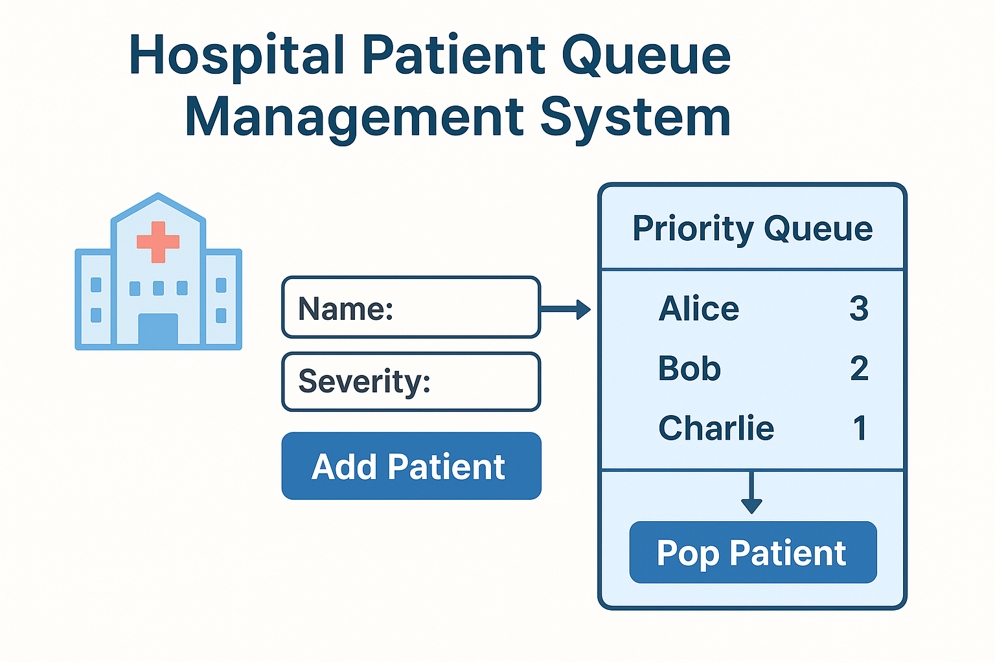

Slide 2
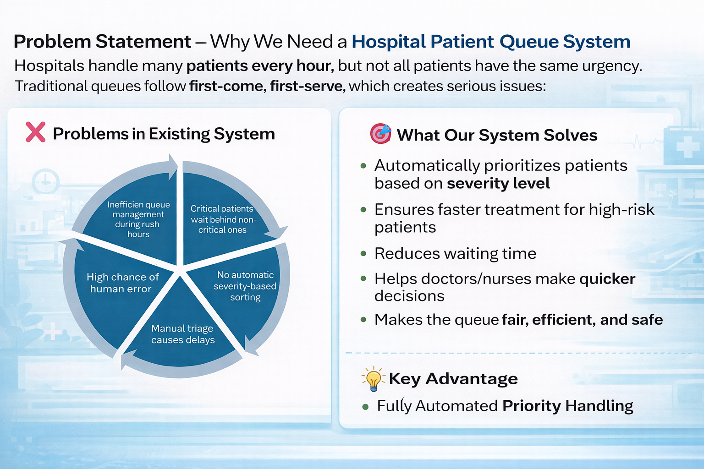
Problem Statement – Why We Need a Hospital Patient Queue System Hospitals handle many patients every hour, but not all patients have the same urgency. Traditional queues follow first-come, first-serve, which creates serious issues:
❌ Problems in Existing System
🎯 What Our System Solves
Critical patients wait behind non-critical ones
No automatic severity-based sorting
Manual triage causes delays
High chance of human error
Inefficient queue management during rush hours
Automatically prioritizes patients based on severity level
Ensures faster treatment for high-risk patients
Reduces waiting time
Helps doctors/nurses make quicker decisions
Makes the queue fair, efficient, and safe

Slide 3
What We Built
A Patient Queue Management System that prioritizes patients based on severity level
Ensures critical patients are treated first
Uses efficient data structures for fast insertion and retrieval
Why It’s Useful
Reduces waiting time for emergency patients
Improves hospital workflow and fairness
Eliminates manual errors in patient ordering
Severity Levels
🔴 Critical (Highest Priority)
🟠 Serious
🟡 Normal

Slide 4
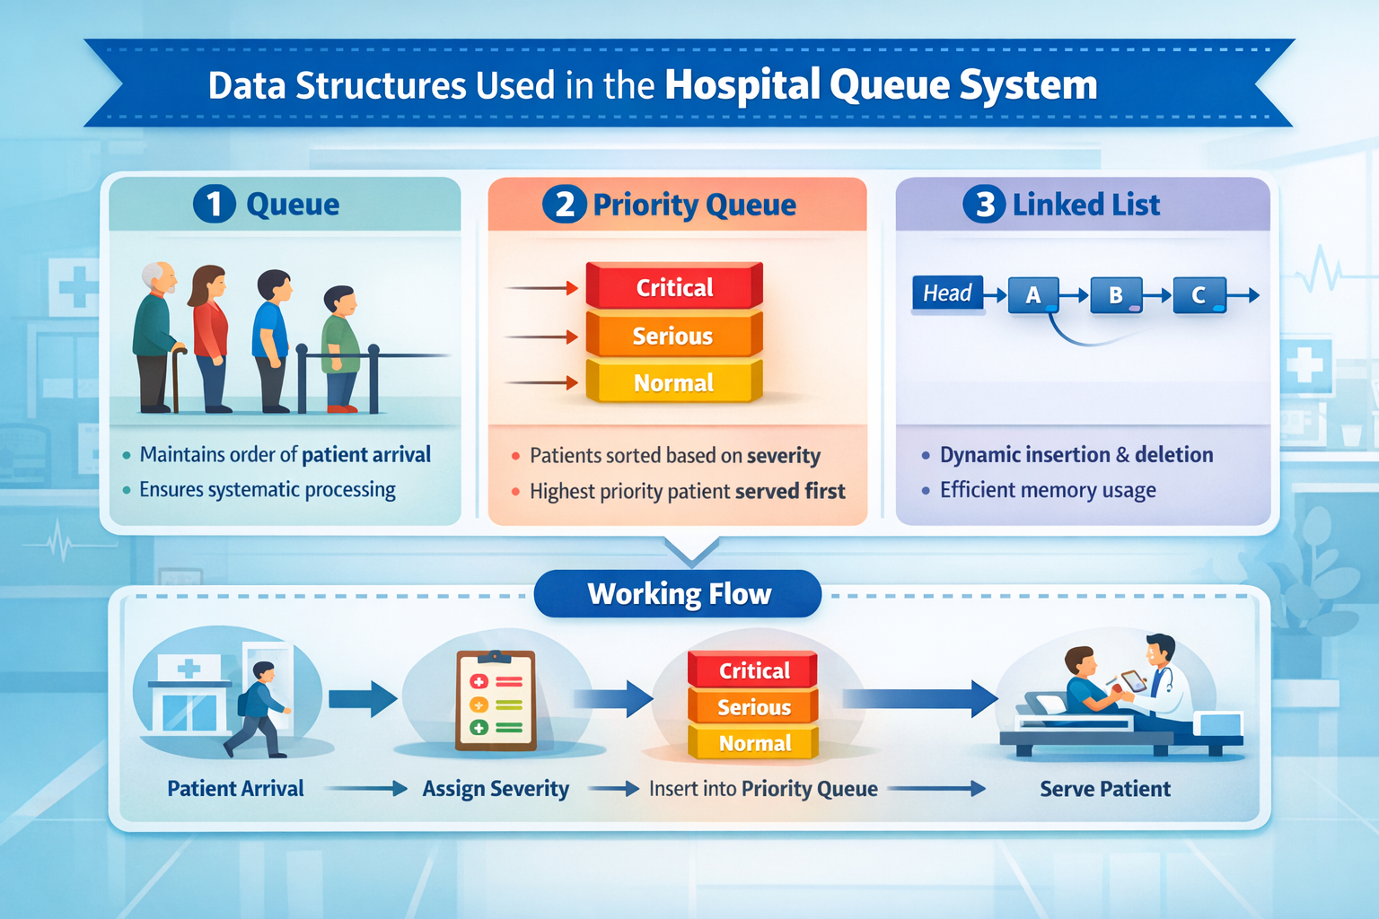
Data Structures Used & Working
1️⃣ Queue
Maintains order of patient arrival
Ensures systematic processing
2️⃣ Priority Queue
Patients sorted based on severity
Highest priority patient served first
3️⃣ Linked List
Dynamic insertion & deletion
Efficient memory usage
Working Flow
Patient Arrival → Assign Severity → Insert into Priority Queue → Serve Patient

Slide 5
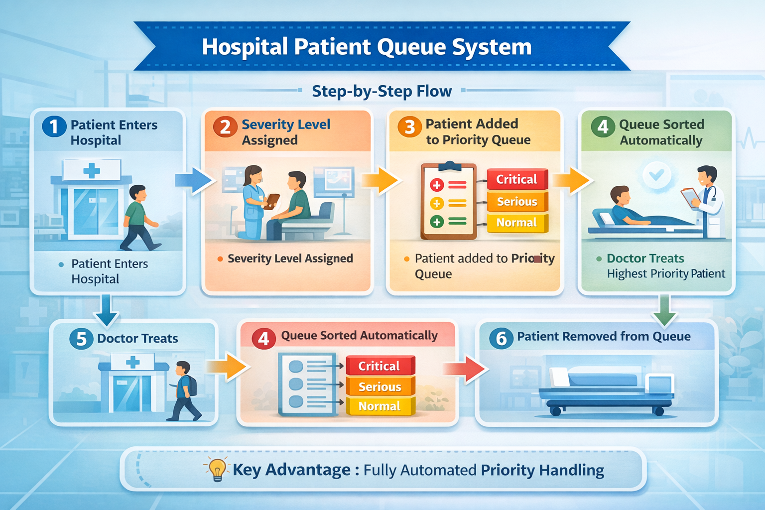

Slide 6
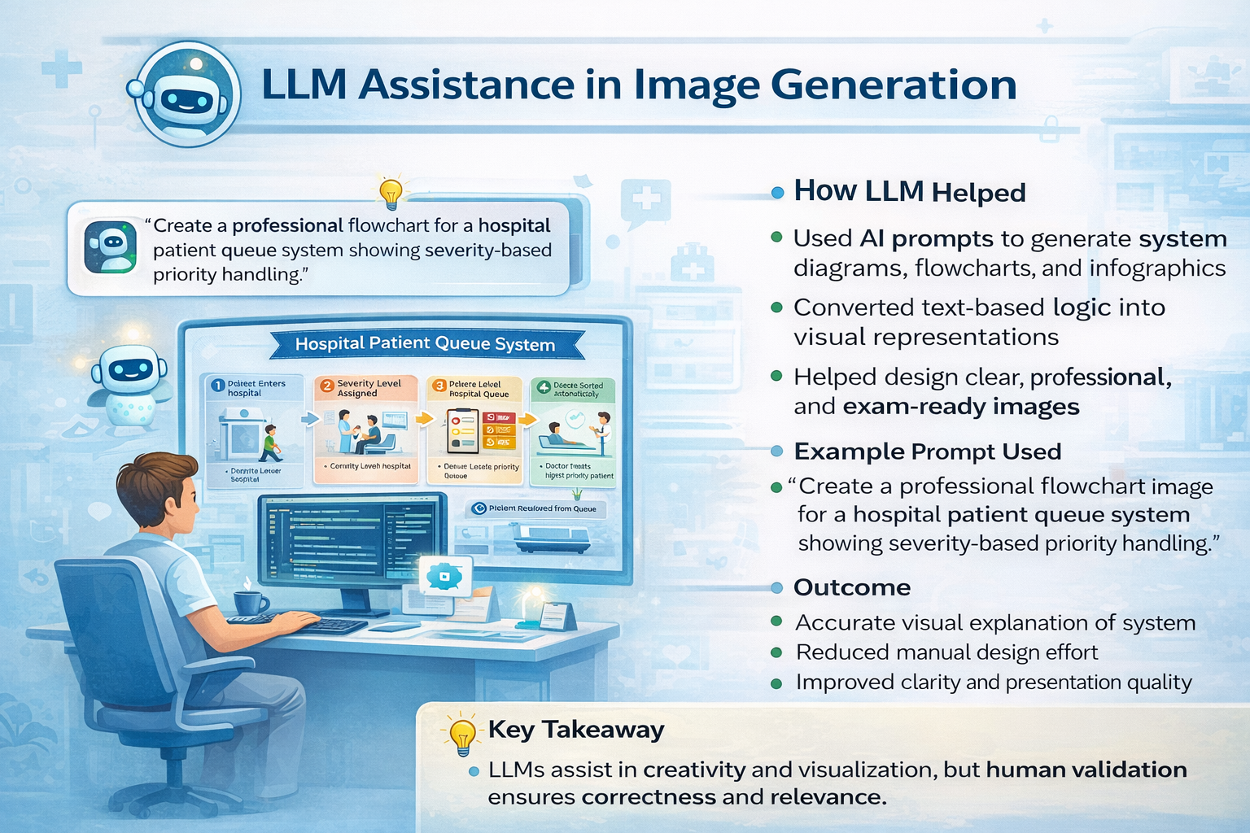
How LLM Helped
Generated initial C/C++ code for priority queue
Helped in logic explanation & debugging
Assisted in flowchart and documentation
Sample Prompt
“Write a C program using priority queue for hospital patient management system”
Output Critique
✔ Correct logic
✔ Readable structure
❌ Required optimization
❌ Needed manual comments & validation
Final Code
Improved efficiency
Added user input validation
Added comments for clarity

Slide 7

Reflection & Learning Outcomes
What I Learned
Practical use of queues & priority queues
Importance of data structures in real systems
How LLMs assist but human logic is essential
Challenges Faced
Priority handling logic
Maintaining sorted order
Avoiding duplicate patient entries
How I Solved Them
Debugging step-by-step
Testing multiple severity cases
Optimizing insertion logic

